Slide 1


SettlementUI
User Guide – November 2024
V3.0

Slide 2

Table of content
SettlementUI - Overview
SettlementUI – Detailed view
SettlementUI – Market Party Validation
SettlementUI – Monthly & Daily Reports
SettlementUI – Overview of available Reports
Q&A

Slide 3
Settlement UI
Elia has created an application that publishes detailed settlement information geared towards service providers. Settlement UI (User Interface) is a secured platform built by Elia for the publication of data used for the settlement of ancillary services and congestion management.
Providers of system services can use the platform to consult data used for the remuneration of balancing, congestion, voltage control and black start services, for instance.

Slide 4

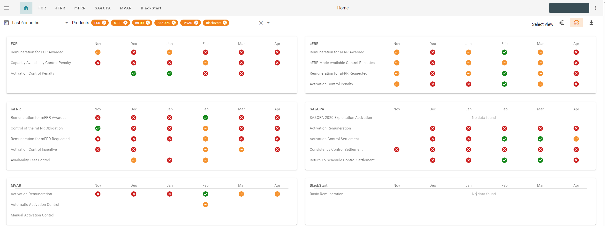



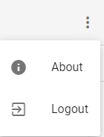

1. SettlementUI – Overview [Validation Status View]
Display navigation sidebar
Navigation product menu
Filters applied on overview
Log off button
Switch view button
Visualisation of status. Report available with hyperlink on icons
Naming aligned with contract vocabulary
The landing page give you overview on validation status of products, financial view, and direct access to invoice proposals.

Slide 5
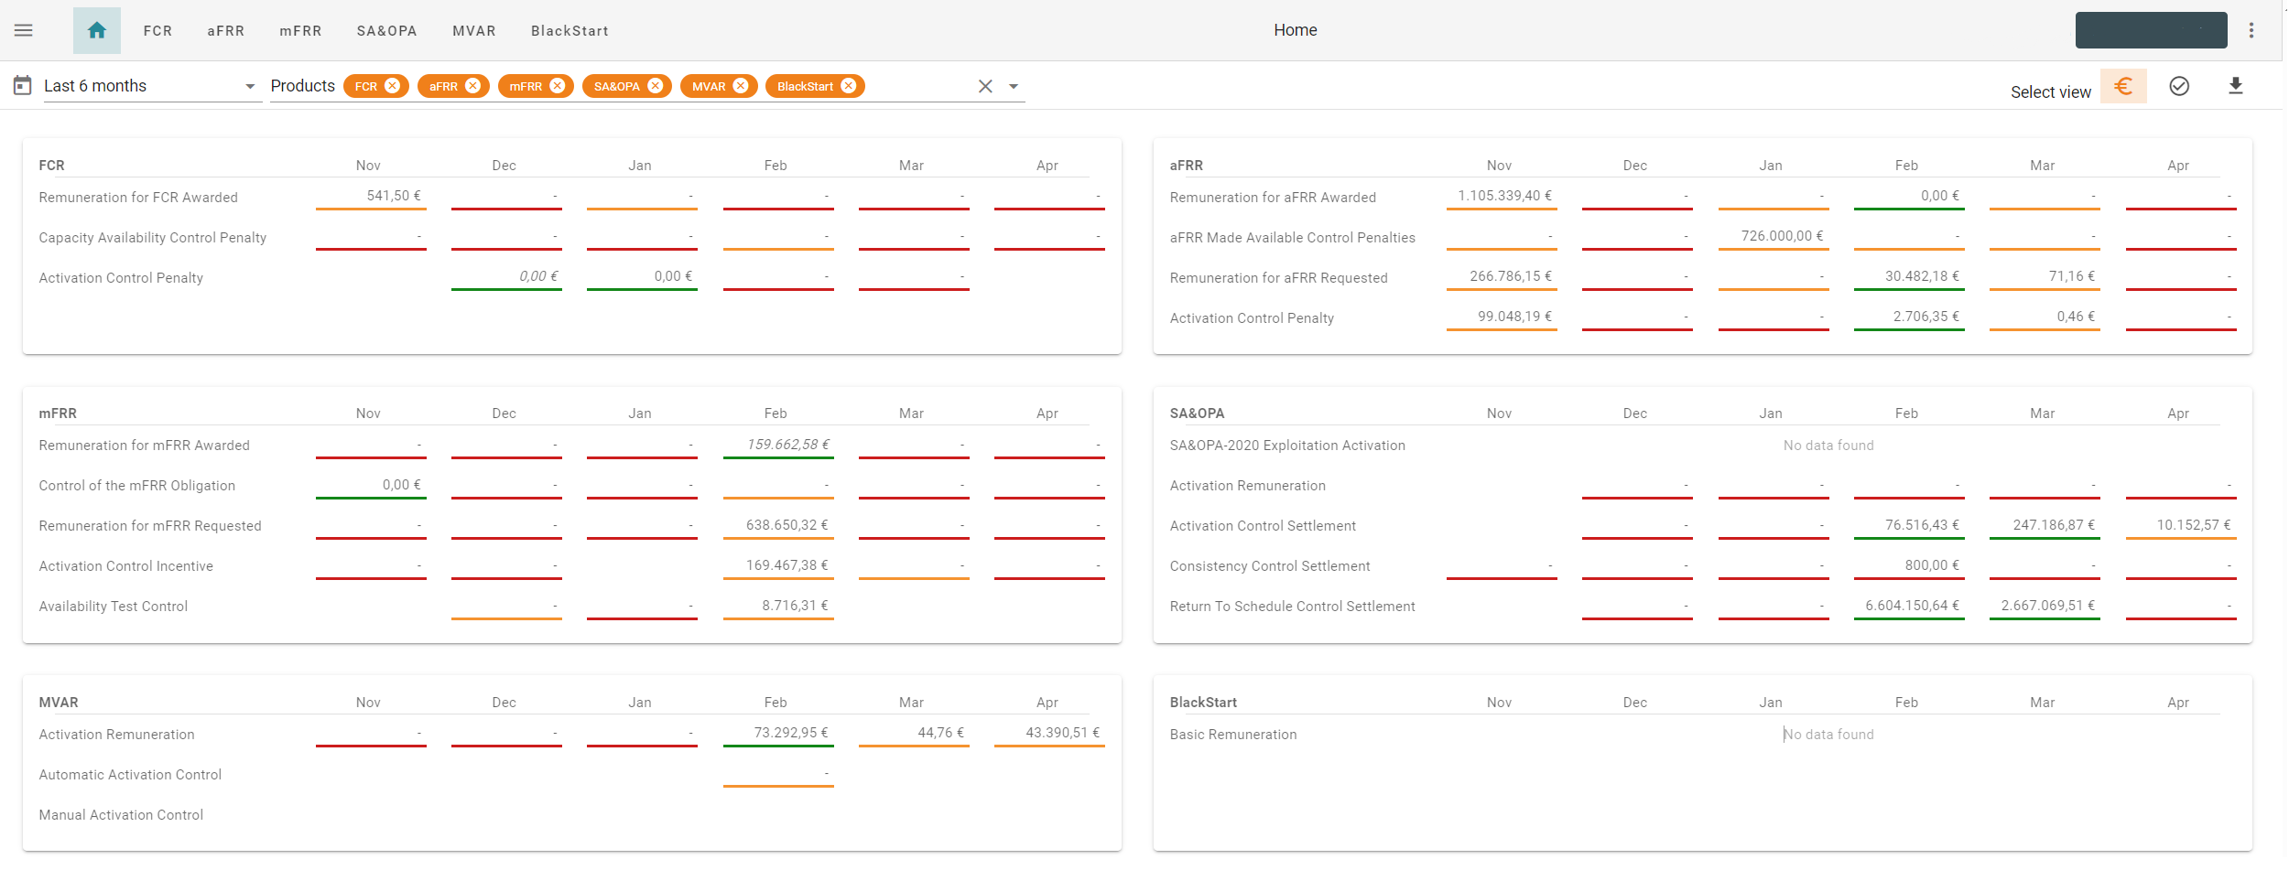
1. SettlementUI – Overview [Financial View]
Display navigation sidebar
Navigation product menu
Filters applied on overview
Log off button
Switch view buttons
Colors gives indication of validation status
(Not Validated, Partially Validated, Validated)
Financial remuneration/ incentive/settlement (Amount represents: no data, some days , all days )
Naming aligned with contract vocabulary
The landing page give you overview on validation status of products, financial view, and direct access to invoice proposals.

Slide 6
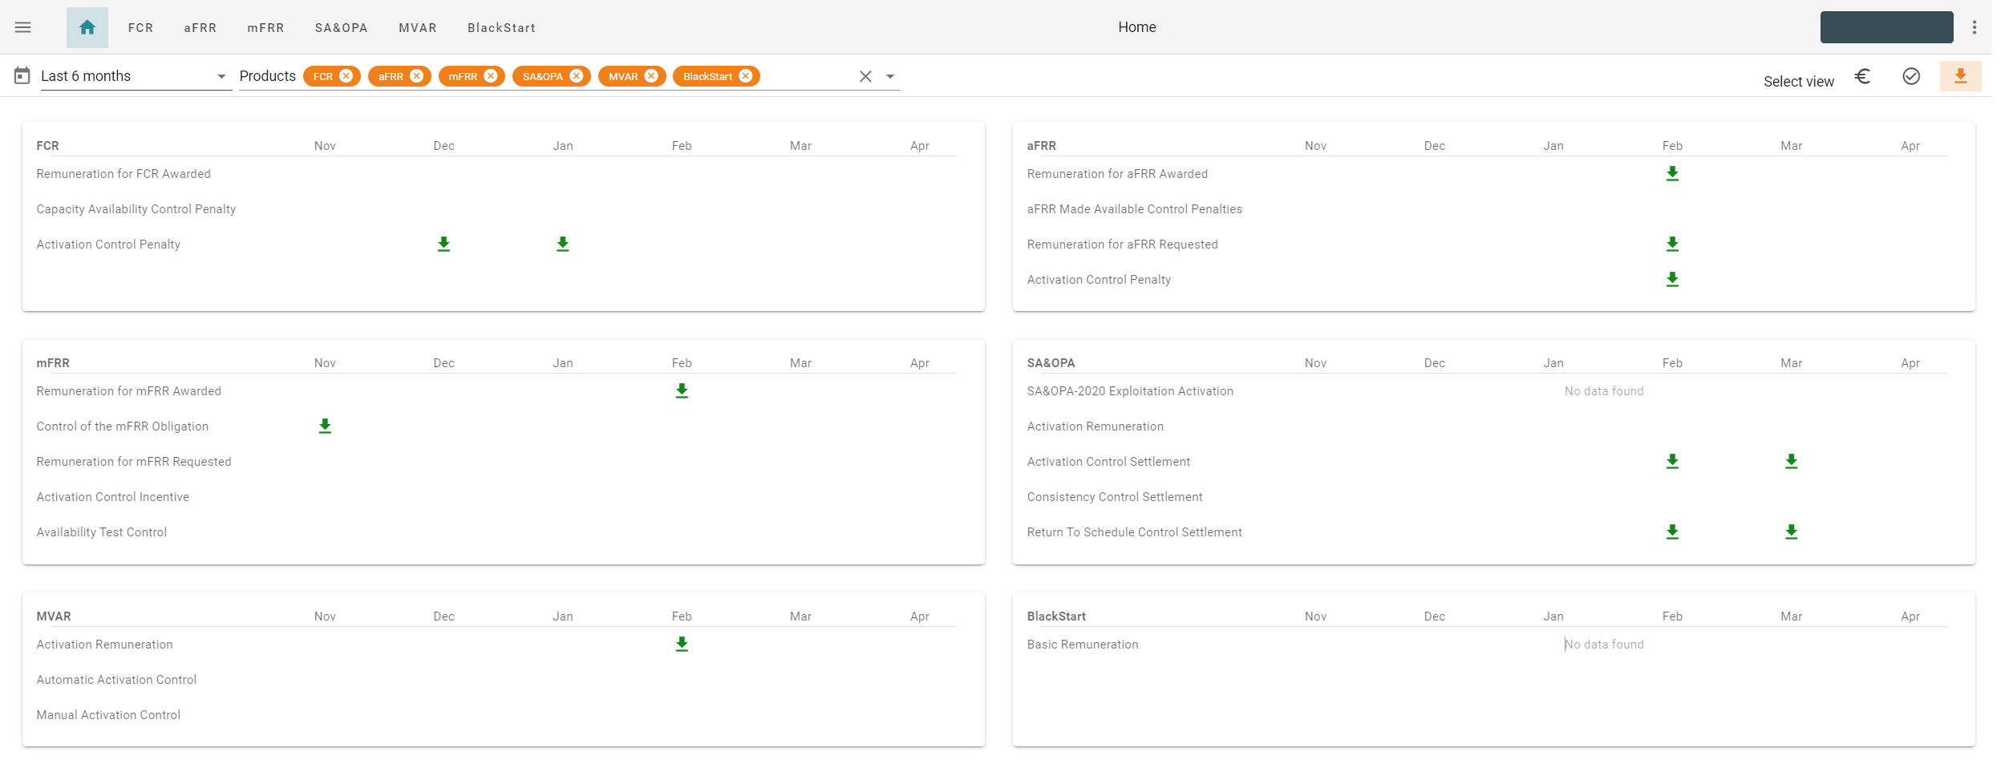
1. SettlementUI – Overview [Invoice Proposal Download View]
Display navigation sidebar
Navigation product menu
Filters applied on overview
Log off button
Switch view buttons
Download button (Invoice proposals are available after final validation by Elia; also sent by email)
The landing page give you overview on validation status of products, financial view, and direct access to invoice proposals.

Slide 7
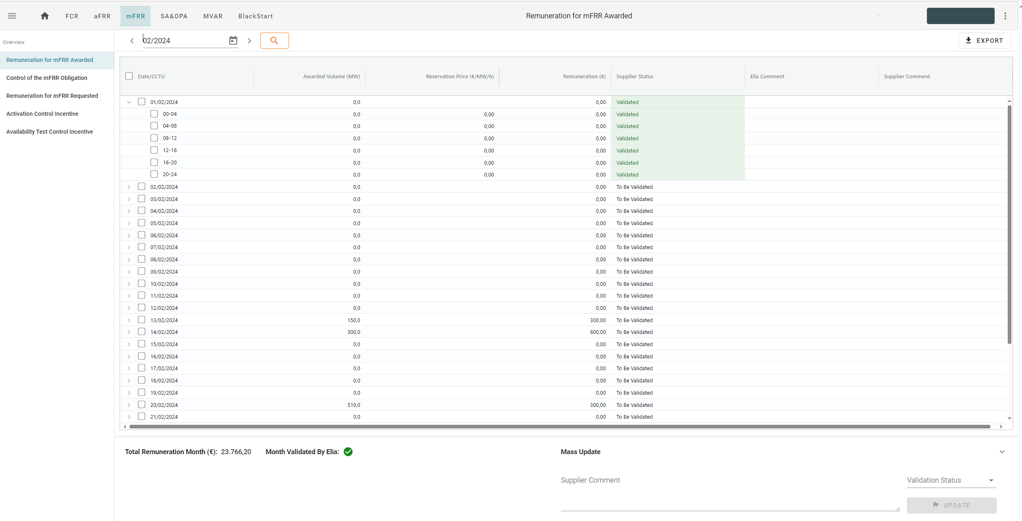


2. SettlementUI – Detailed View
New path to export report (monthly validated data of the table)
Date Filtering for exportable report
List of settlement processes for this product
Expand button to display detailed aggregated figures
Validation Status update by market party on selected items (see next page)
Aggregated figures
Validation issue of period by Elia
Market Party comment
Detailed view of a specific settlement. On each monthly detailed screen, market party can optionally validate the month and/or send comments to Elia settlement team.

Slide 8
3. SettlementUI – Market Party Validation
Market party can validate, or reject timeseries of products, directly from the reports view. A comment section is also at disposal. These information eases communication with Elia settlement team (Market Operation).
Market Party comment
Validation Status update by market party on selected items
Update

Slide 9
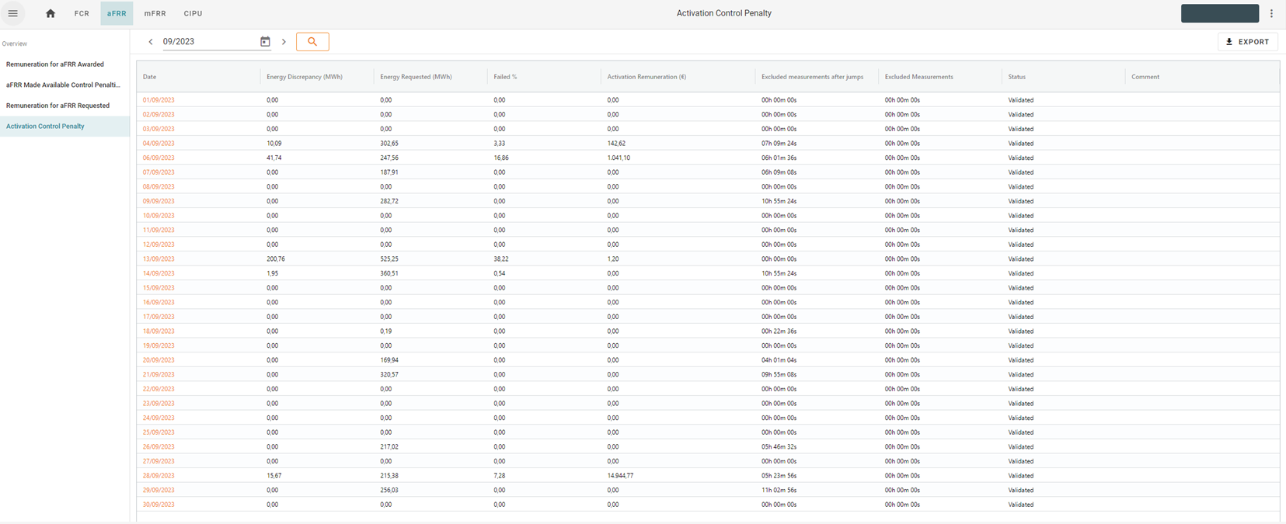
4. SettlementUI – Monthly & Daily Reports access
New path to export report (monthly validated data of the table)
Daily Report available with hyperlink
Path to export monthly reports. Some specific reports are accessible via hyperlink on period click.

Slide 10
5. SettlementUI – Overview of Available Reports
Product | Process | Report | Access
FCR | Remuneration for FCR Awarded | Capacity Remuneration Details | Export Button
FCR | Capacity Availability Control Penalty | Capacity Availability Details | Export Button
FCR | Capacity Availability Control Penalty | Capacity Availability Summary | Export Button
FCR | Capacity Availability Control Penalty | Weighted Capacity Price Details | Hyperlink on report
FCR | Activation Control Penalty | Activation Control Details | Export Button
aFRR | Remuneration for aFRR Awarded | Capacity Remuneration Details | Export Button
aFRR | aFRR made Available Control Penalties | Capacity Availability Summary | Export Button
aFRR | Remuneration for aFRR Requested per Bid | Activation Remuneration Details | Export Button
aFRR | Remuneration for aFRR Requested | Activation Remuneration Details | Export Button
aFRR | Activation Control Penalty | aFRR Activation Control Details | Hyperlink on report
aFRR | Activation Control Penalty | Activation Control Summary | Export Button
mFRR | Remuneration for mFRR Awarded | Capacity Remuneration Details | Export Button
mFRR | Control of the mFRR Obligation | Weighted Capacity Price Details | Hyperlink on report
BlackStart | Basic Remuneration | Basic Remuneration Details | Export Button
BlackStart | Availability Control | Availability Control Details | Export Button
BlackStart | Availability Test | Availability Test Details | Export Button
Product | Process | Report | Access
mFRR | Control of the mFRR Obligation | Capacity Availability Details | Export Button
mFRR | Control of the mFRR Obligation | Capacity Availability Summary | Export Button
mFRR | Remuneration of mFRR Requested | Activation Remuneration Details | Export Button
mFRR | Activation Control Incentive | Activation Control Details | Export Button
SA&OPA | Activation Remuneration | Activation Remuneration Details | Export Button
SA&OPA | Activation Control Settlement | Activation Control Details | Export Button
SA&OPA | Activation Control Settlement | Redispatching Activation Control Bid Details | Hyperlink on report
SA&OPA | Consistency Control | Consistency Control | Export Button
SA&OPA | Consistency Control Details | Consistency Control Details | Export Button
SA&OPA | Return To Schedule Control Settlement | Return To Schedule Control Details | Export Button
MVAR | Activation Remuneration | Activation Remuneration Summary | Export Button
MVAR | Activation Remuneration | Activation Remuneration details by DP | Export Button
MVAR | Automatic Activation Control | Activation Control Summary | Export Button
MVAR | Automatic Activation Control | Activation Control Details by DP | Export Button
MVAR | Manual Activation Control | Manual Activation Control by DP | Export Button

Slide 11
6.Q&A
Do I have to perform any actions?
No, new functionalities are automatically deployed and accessible through your current url.
Are historical data always accessible?
Yes
I have additional question?
Please contact your KAM energy and/or Market Operations (system.services@elia.be).

Slide 12
Thank you.

